Slide 1
Introducing “threshold graphics” (TGs): teaching-learning & researching threshold concepts via inquiry graphics
Dr Nataša Lacković, Twitter: @natasa_wonders
Lancaster University, UK

Slide 2
What are threshold graphics?
Threshold Concepts
Inquiry Graphics
Threshold Graphics: inquiry graphics applied to address threshold concepts.

Slide 3
Notes:
Image starts at 9:51, ends at 11:26. Image on the cover copyrights: @Natasa Lackovic 2020; the cover by Palgrave McMillan.

Slide 4
What are inquiry graphics?
Inquiry graphics are “graphics” that are applied in teaching-learning & research to support:
explorations of disciplinary concepts,
creative thinking (analogical, imaginative),
critical concept analysis,
externalisation of shared/unique concept interpretations in a learning community,
an awareness of conceptual, experiential and interpretative pluralism.
Graphics: (from Greek γραφικός graphikos, "belonging to drawing“) broadly, anything that leaves a trace on a surface such as a paper or screen surface; graphics could be static/still (e.g. a photograph, non-animated drawing, collage, murals/graffiti, graphs, but also words) and animated (a video, an animation, any graphics in motion). I have mainly explored depictive visual media as inquiry graphics ingredients.
Multimodal inquiry (an ongoing development) - An analytical learning inquiry across multiple modes and senses: graphics, words, and beyond, to include
touch, movement, dance, feel (…of the atmosphere)

Slide 5

Why exploring threshold concepts through graphics?
To overcome and challenge persistent dualisms in education: mind-body, image-concept, feelings/emotions-reasons, concrete-abstract
To take visual and material culture as well as embodied experiences seriously in the formation and development of concepts/overcoming TCs
Careful attendance to images and visual analysis can help provide access to visual culture to visually impaired and blind people – why would we not get used to describing images in depth and in layers? Why would we deprive anyone from access to visual culture?
Images are carriers of power and ideology and suggest meanings about what the world is like – they need reflection and unpacking

Slide 6
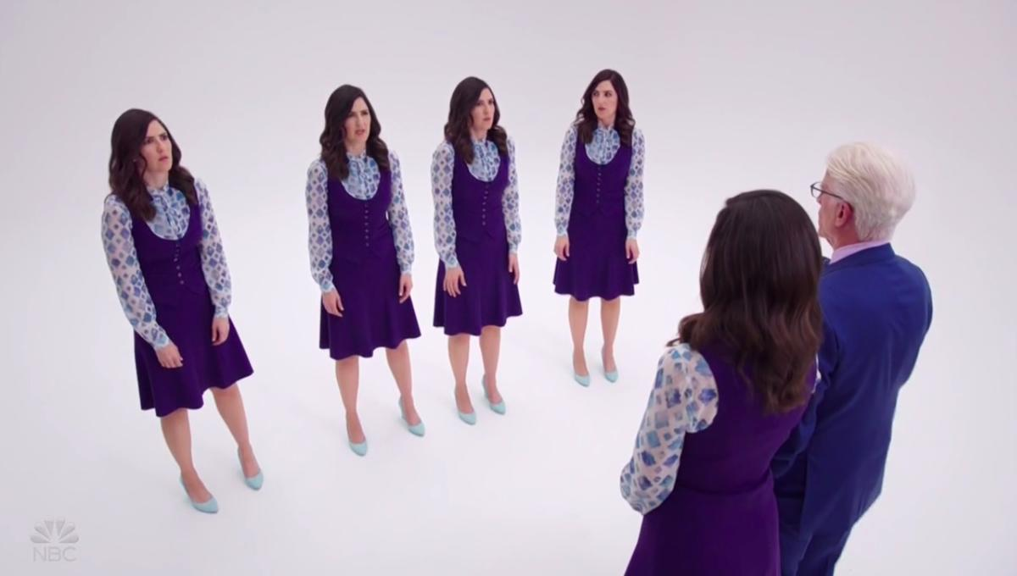
We do not live in a “conceptual world” that is deprived of
sensory and embodied experiences – we are surrounded by and embedded in materiality and/or visuality of the world. The concepts in the world are interpreted from multiple vantage points – educational spaces are not full of identical clones with the same prior knowledge, context or experiences.

Slide 7
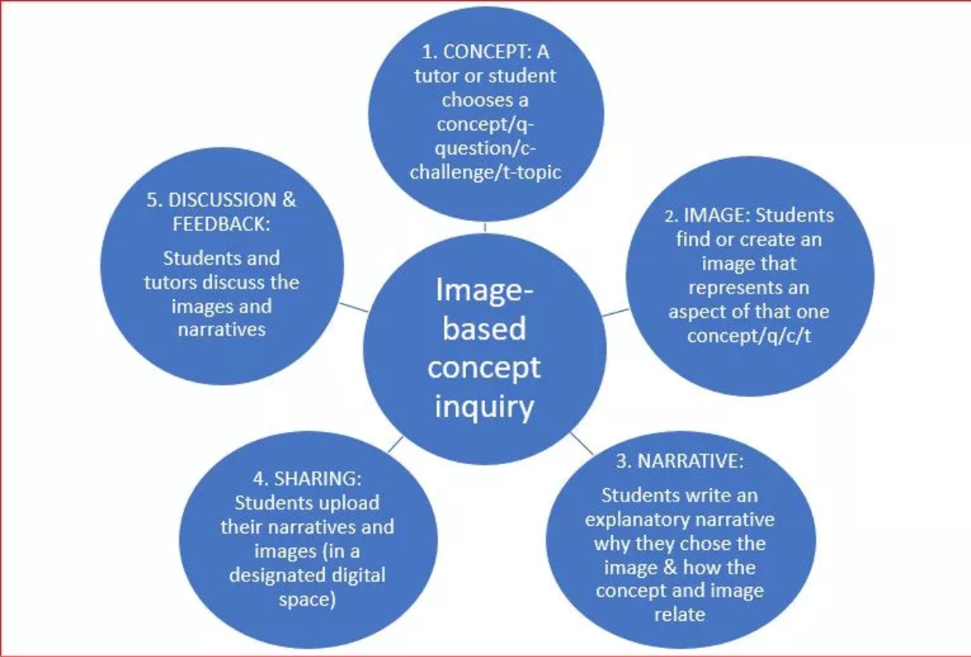
An Inquiry Graphics pedagogic design (IBCI)

Slide 8
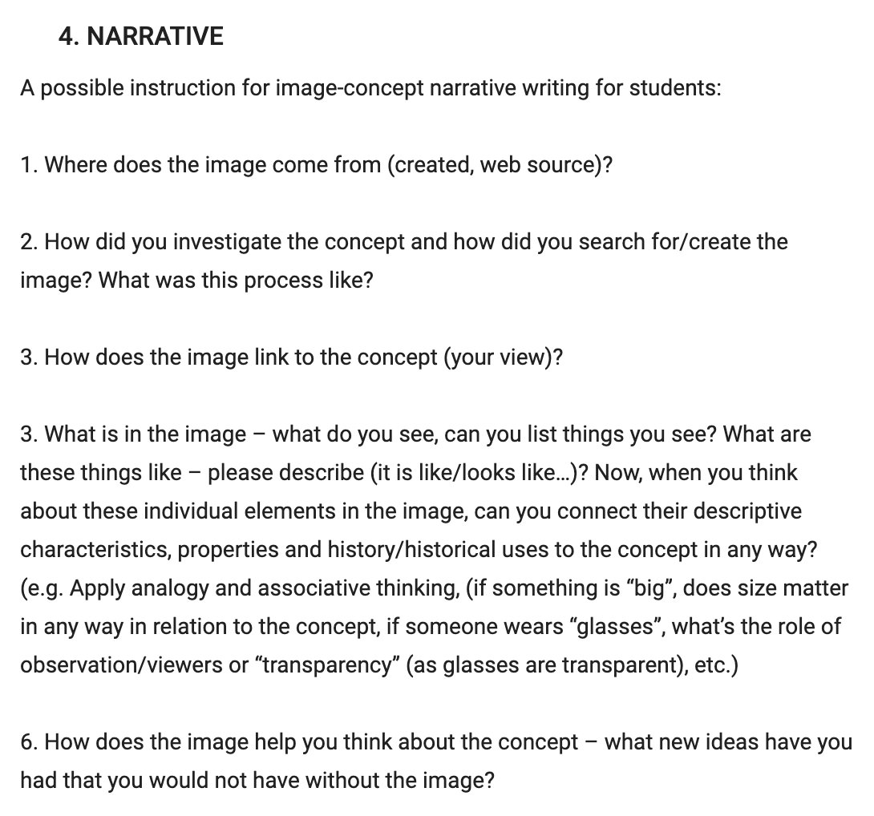
Potential instructional support

Slide 9
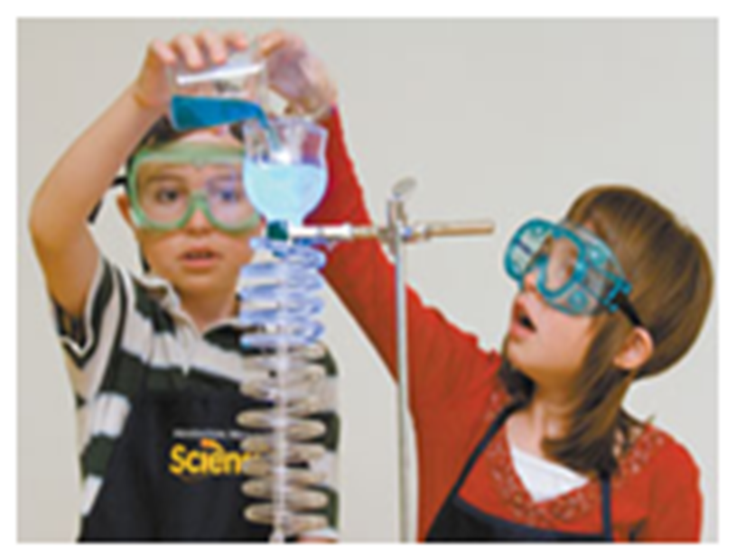
SIG
Representamen
(Signifier)
Interpretant does image relate to nchored object:
(led by your RQ)
An IG/TG analysis example: Educational Psychology, TC “Constructivism”
Micro (Image) (REPRESENTATION/REPRESENTAMEN/PERCEPTIVE STATEMENTS) What things are in an image? A list individual things | Meso (Image) (IMAGE INTERPRETATIONS) (Denotation-Connotation) D: Qualitative perceptive descriptions- What is it like? C: Strongly socio-cultural meanings – How is it socio-culturally defined? Good to explore personal approach/bias | Macro (Image-Concept) (CONCEPT LINKAGE/ANCHORAGE) The concept – Generalisation and Critique: (led by RQ/conceptual inquiry) RQ: How does the image relate to the concept (“constructivism”)? How to explore, understand & critique “constructivism” through this image?

Slide 10
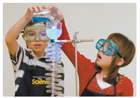
MICRO - Elements: boy, girl, clothes, /apron, /goggles, dishes, /liquid, /spiral
MESO –
DENOTATION (ELEMENT)–
QUALITATIVE DESCRIPTION - GOGGLES:
The boy and the girl are wearing goggles.
MACRO – (ELEMENT)
CONCEPTUAL INSIGHT: Wearing goggles can be related to “protection” - a health and safety Issue in constructivism. Health and safety issues might be an obstruction in constructivist learning at schools. Would the children remember to put on goggles independently?
This raises issue of the “independent child” argument in constructivism
MESO –
DENOTATION (whole picture)–
QUALITATIVE DESCRIPTION:
the boy is holding a glass with blue liquid pouring it down a spiral glass tube, with the girl touching the glass in a presumed action of pouring, standing next to him. The two children are shown/photographed alone.
MESO
CONNOTATION (ELEMENT):
The pupils are wearing goggles to protect themselves (during an experiment). (multimodal anchorage point – points where image and concept meet)
MACRO (WHOLE PICTURE)
CONCEPTUAL INSIGHTS:
Focusing on solitary children’s exploration is common in constructivist representations and needs to be contested. Adult as omitted but still influencing the image (the role of teacher agency and guidance in constructivism); there are few females in “hard” sciences, representing girls as scientistic can change the imbalance.
MESO
CONNOTATION (whole picture):
The two pupils are having what is called “hands-on” experience of chemistry concepts by participating in an experiment, which is a classical example of “constructivist environment and experience”. There is not teacher present/shown.

Slide 11
Multimodal Anchorage Point
(visual/graphic-linguistic (speech/narrative) link or anchorage)
Image
Narrative
CONCEPT
MAP
Goggles
Constructivism
Anchorage: Barthes (1976)

Slide 12
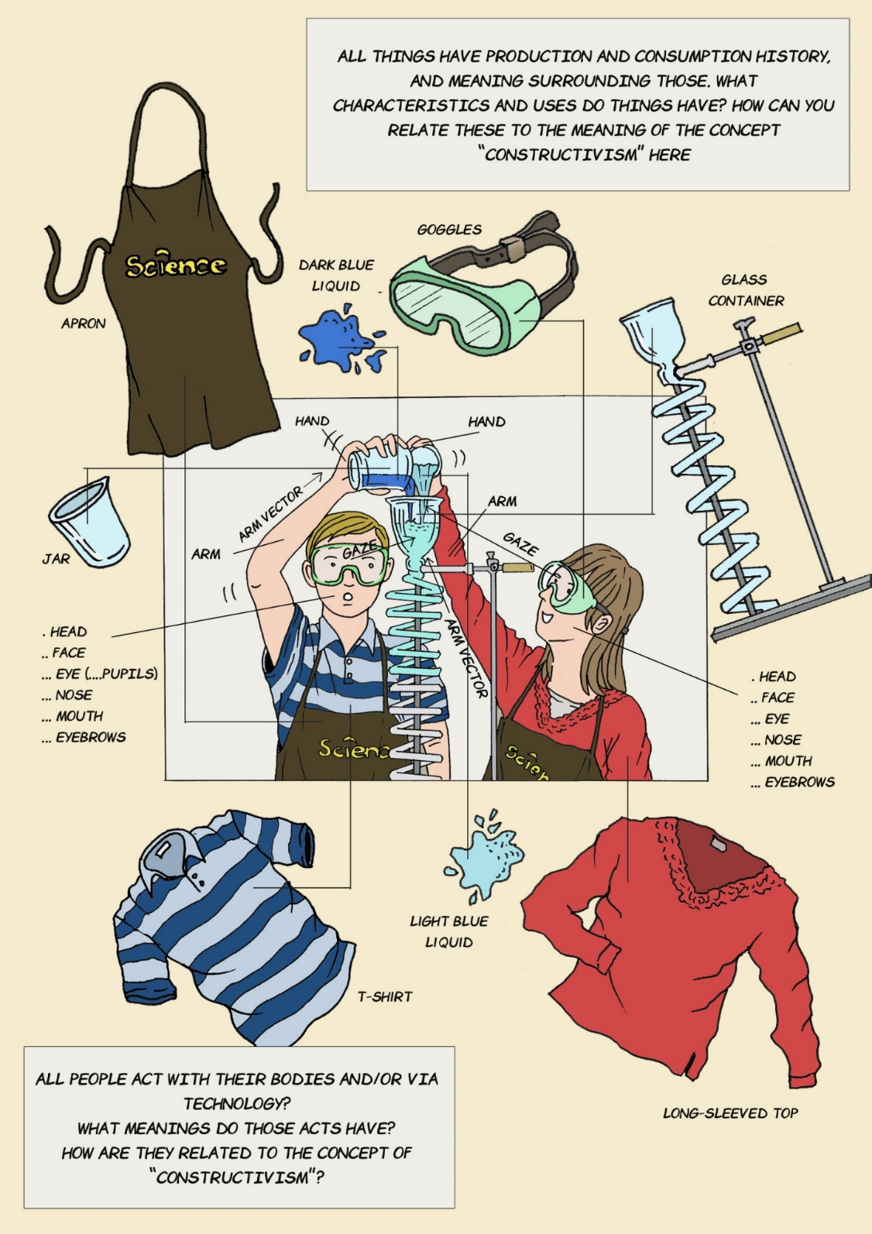
Puna ilustracija

Slide 13
Some aspects of inquiry and threshold graphics
Iconic Surfacing: when any held stereotypical icon (image) surfaces to one’s mind when thinking of images to represent concepts; stereotypical image exposure (from the subconscious) and subsequent critical reflection on it; an IG pedagogy and analysis expose stereotypical images of our mind schemata which helps to address personal bias and stereotypical ideas or images linked to a concept
Multimodal Anchorage The image–concept linkage made in a narrative or any verbal reflection or hybrid (artistic) expression; it means to link an aspect of the pictorial sign (element, description) with a theoretical perspective or abstract concept statements and ideas.
Multimodal Anchorage Elaboration When any image-concept linkage made is reflected upon in further depth and a line of associations, analogies, inferences.
Disciplinary contexts and doctoral research: Medical Education, Occupational therapy, Physics, Social Care, Psychology…It is wonderful to have the opportunity to work on TG/TC/IG with an amazing group of doctoral researchers at LU

Slide 14
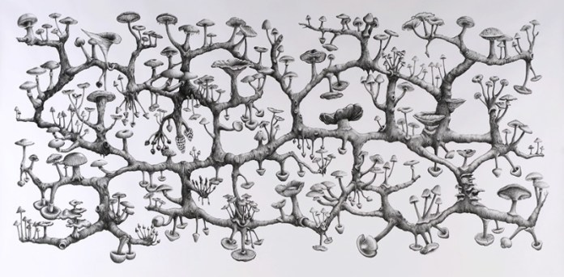
TC/IG as concept-rhizome (rhizome), rhizomatic concept:
“concept as imbued with a variety of modal meaning potentials and many pathways for logical and creative insight, depending on varied contexts, interpreters and environments. (p.360)”
Saw this tweet in the morning: Quite a time ago, Diane Reay wrote this excellent paper – “It’s all becoming a habitus: beyond the habitual use of habitus in educational research”….I think we need her or someone else to do the same for rhizomes, Deleuze, and Guattari.
Richard Giblett Recent work : 2006-2009 Represented by Galerie Dusseldorf 21. Mycelium Rhizome, 2009 Pencil on paper 120 x 240 cm Collection of the artist Represented by Galerie Dusseldorf

Slide 15
Thank you
TG/IG ARE ALSO A THRESHOLD CONCEPT ☺

