Slide 1

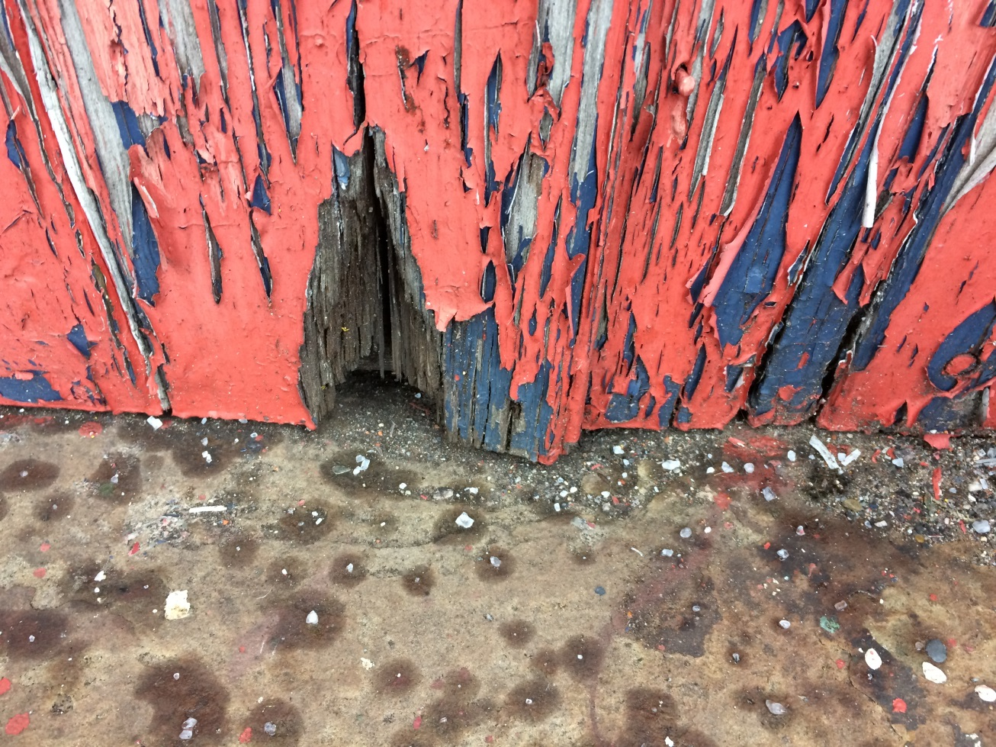
Can an Arts-Based Liminal Learning Experience Change Learning Cognition?
Catherine Ross
MPhil/PhD student, School of Arts, Oxford Brookes University

Slide 2
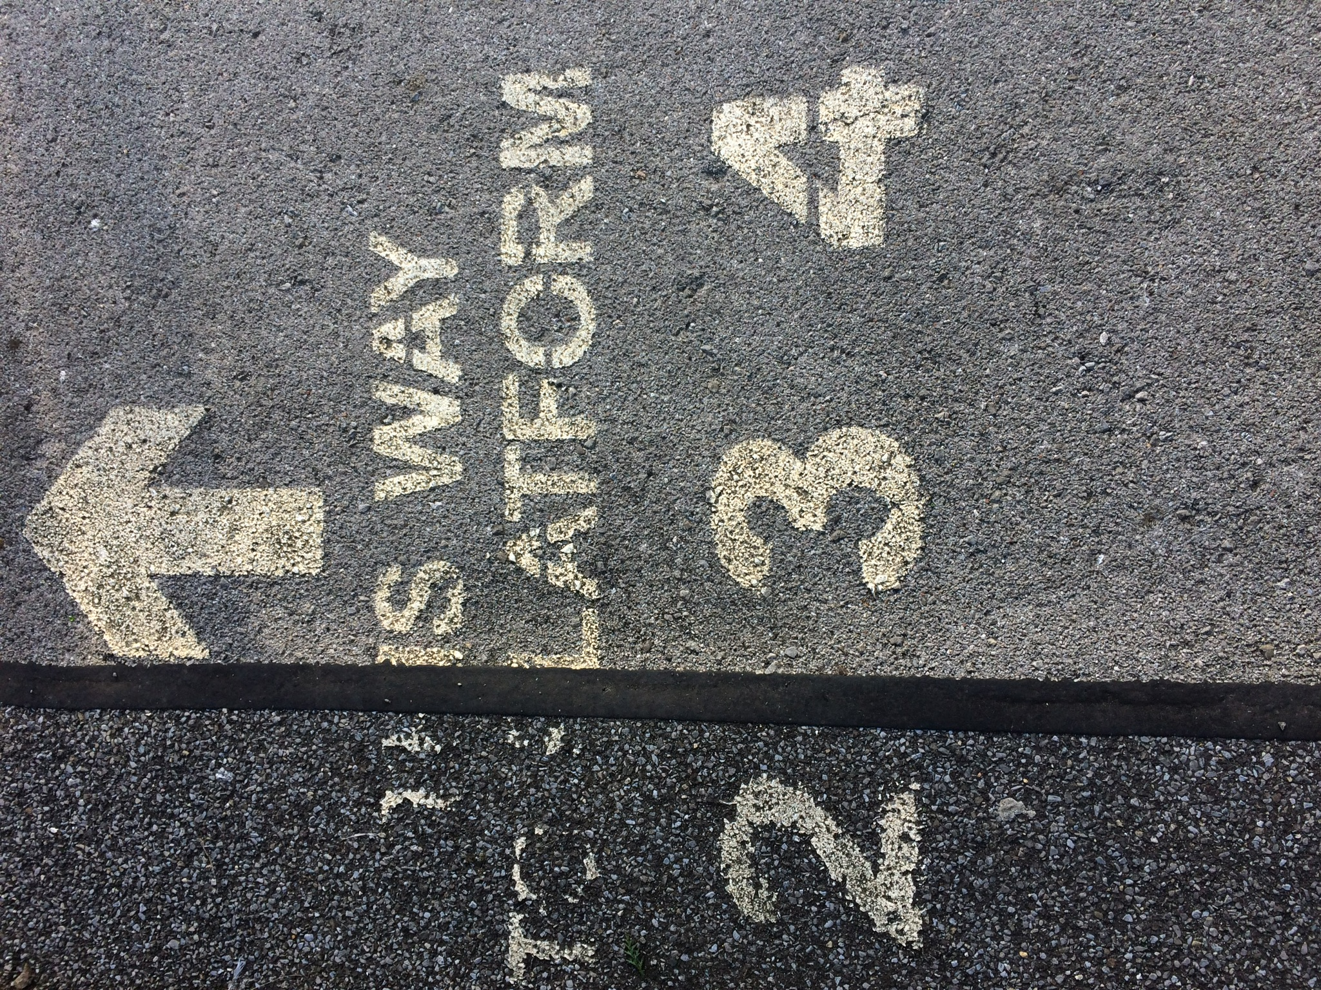
Introduction
Can an arts-based Liminal Learning Experience (LLE) change learner cognition?
I have been focusing on liminality since 2017 in my art practice on my MA in Education (2015-2018) and subsequent Fine Art MPhil/PhD (2019-2024) at Oxford Brookes University.
This presentation reports on a research project undertaken to determine if an LLE changes learner cognition. My analytical micro-ethnographic study was conducted at Salisbury Railway Station and in the art studio of an FE College.
‘This way’ 2018. Digital photograph (Catherine Ross)
Notes:
Analytical micro-ethnography = focused, exploratory, time-bound study of everyday interactions in a small group setting (Johnston 2012; Hammersley and Atkinson 2007).

Slide 3
Project Aims/Objectives
Aim
To investigate if it is possible to design a liminal learning experience (LLE).
Objectives
To test arts-based researcher-designed workshops with a small group of adult learners.
To supervise an end-of-project focus group interview on participants’ experiences.
To analyse data to decipher if an LLE can change learning.
To promote change, risk taking and self-awareness in participants.

Slide 4
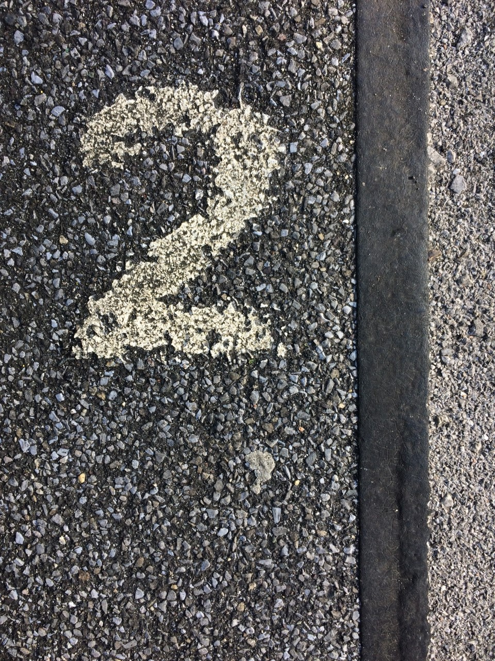
Rationale
How is a liminal approach useful within wider learning?
Learning is the transfer of retained knowledge and a revision in world views. When learning is demanding, flexible and multi-contextual memories become more fluid and long-lived (Didau 2016). I wanted to give this opportunity to learners; mirroring the commitment in tertiary adult education to life-long learning. Liminal learning offers an affective, collaborative, evolutionary and multi-level/disciplinary alternative to reshape learning (Tucker 2016).
‘Platform edge’ 2018. Digital photograph
(Catherine Ross)
Notes:
Life-long learning = an inclusive process of facilitating individual empowerment and stimulation in gaining multiple situational understandings and skills (Longworth and Davies 1996 cited in Shanahan 2016). In opposition, nationally the present focus in further education is on fixed, measurable and quantifiable transition points of recruitment, retention and achievement, publicly published and validated. LLE = transformative and risky.

Slide 5
Definition of Liminality
Liminality’s etymological root ‘limin’ is Latin for threshold.
Originated by the anthropologist Arnold Van Gennep (Van Gennep 1909 cited in Turner 1967) in relation to tribal rites of passage.
An indicator of all transformations, spatio-temporal, psychological and cognitive (Turner 1967).
Liminal experiences are axiomatic to the mind or even the brain’s anatomy (Turner 1974).
A cause of anxiety and anguish, simultaneously damaging and productive (Thomassen 2014).
A hegemonic disruptor and disorientator (Levi-Strauss 1978/1995 cited in Elliott 2015) seen in political, social, cultural and educational change.
It is ‘a realm of pure possibility’ where original ideas are born (Turner 1995/1967:97).
Notes:
Liminality is originally an anthropological term. An ambiguous, uncertain, subjective phenomena (Rowley 2018) indicating changes in states, places, social status and age. Marginal and transitional (Turner 1974).

Slide 6
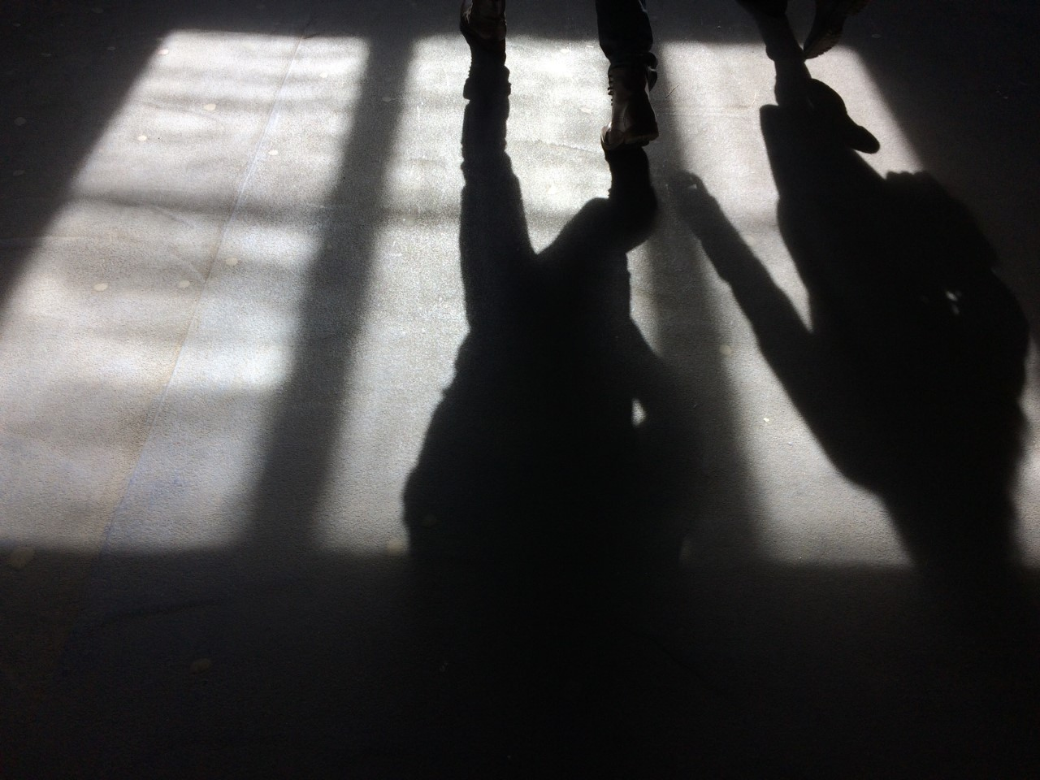
Definition of Liminal Learning Experience and Threshold Concepts
Liminality is important in curriculum design and delivery (Flanagan 2013).
An integral aspect of liminal learning is the threshold concept; a pivotal, critical learning moment, a portal to transformations, vital for progression (Meyer and Land 2006 cited in Carr 2017), leading to improvements in learning (Flanagan 2013). An LLE involves an open, scene-setting brief with structured and non-structured activities where outcomes and criteria are stated, but processes are not.
‘Tunnel’ 2018. Digital photograph (Catherine Ross)
Notes:
Van Gennep’s anthropological definition broadened by British social anthropologist Victor Turner to incorporate Western cultural and societal changes. What, how why disclose different learning elements (Land 2012)?

Slide 7
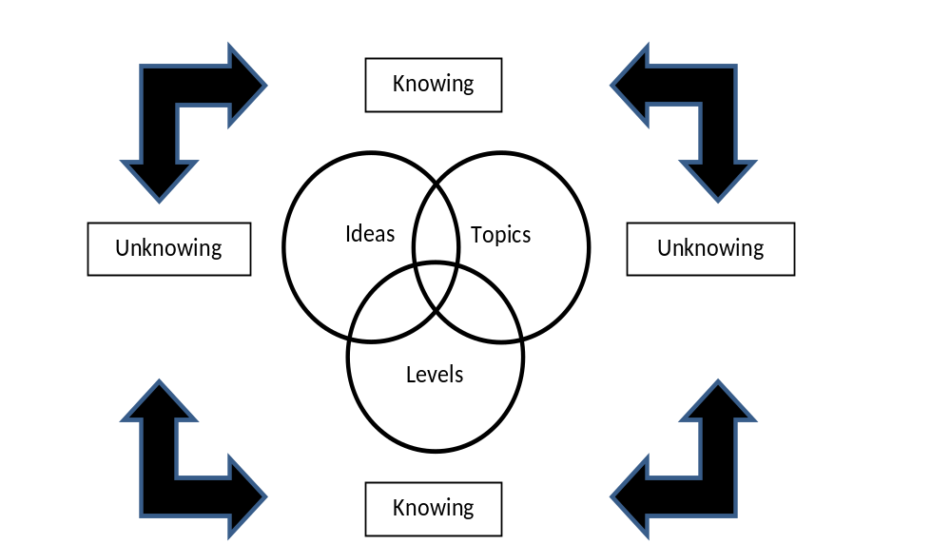
Justification for an LLE
The liminal tunnel can be a disorientating place. Rohr (2013 cited in Carr 2017:1) explains ‘if you are not trained in how to hold anxiety, how to live with ambiguity, how to entrust and wait, you will run anything to flee this terrible cloud of unknowing’.
Neuroscientific findings have revealed that most human thought manifests itself in the visual, metaphors and emotions buried deep in ‘the neurological substrata’ (Zaltman 2003: cited in Stewart et al 2007:12).
The project drew on these manifestations through the metaphor of the station to help learners to hold, trust and wait, not run!
Liminality as recursive/non-linear learning in
opposition to discursive/linear learning
(language based) (Land 2012)
Notes:
LLE = unstable, unsafe, ‘liquid space’, transforming and transformed by the learner (Meyer and Land 2005:380; Cousin 2006:139 cited in Flanagan 2013).

Slide 8
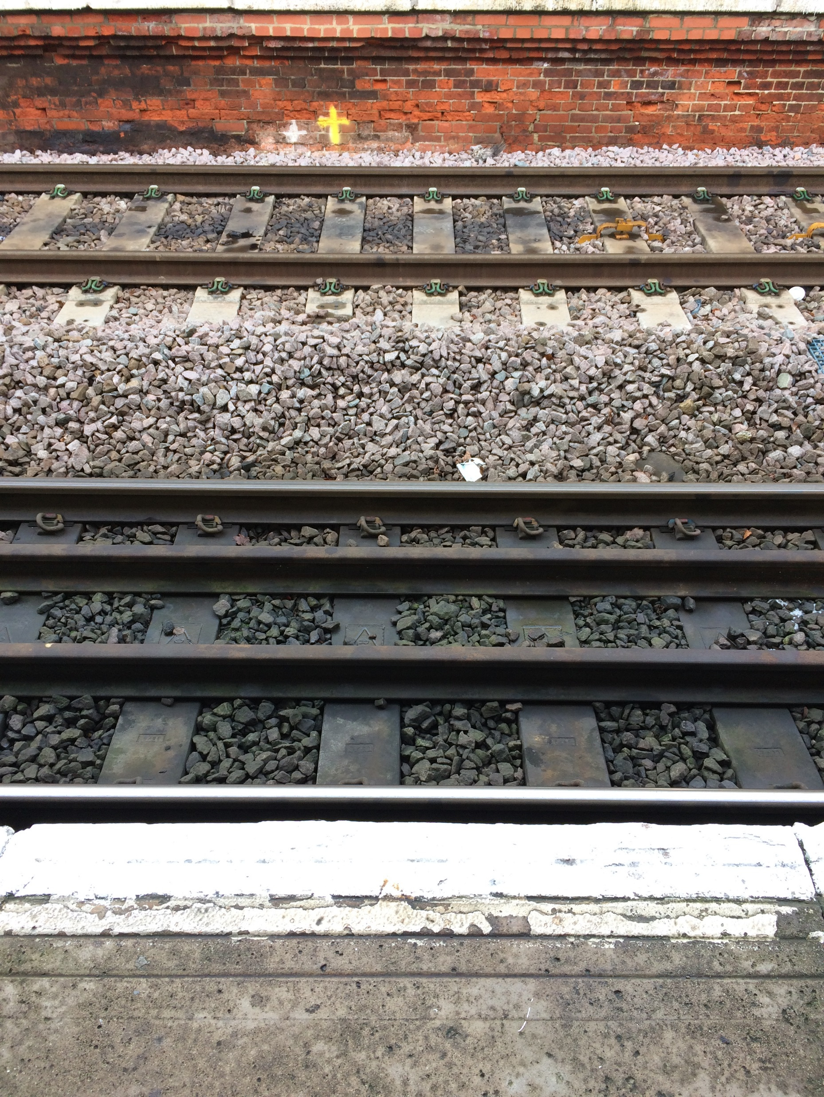
Methodology
My study is situated within an interpretivist paradigm, which is fitting for an analytical micro-ethnographic investigation on the phenomenon of liminality as the topic, paradigm and methodology are all anchored in social meaning-making (Guba 1981 cited in Thomas 2010).
‘Transitional lines’ 2018. Digital photograph (Catherine Ross)

Slide 9
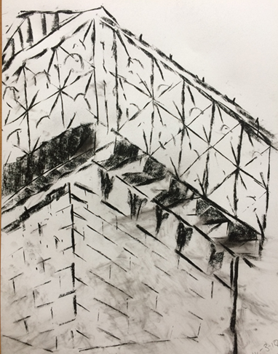
Methods
Three data collection methods were used, students’ sketchbook comments, my reflective blog and a focus group interview.
After triangulation of pilot data some revisions were made. A more experiential approach to liminality engendered access to the learning experience therefore a less prescriptive definition of liminality was given to deepen self-exploration.
The project was challenging, complex and ambiguous in delivery and content. Issues of accessibility, bias, equality, ethics and power relations had to be critically examined.
Charcoal drawing with the left hand 2018.
(Amelie)
Notes:
Risky for teacher. Great challenges and great rewards.

Slide 10
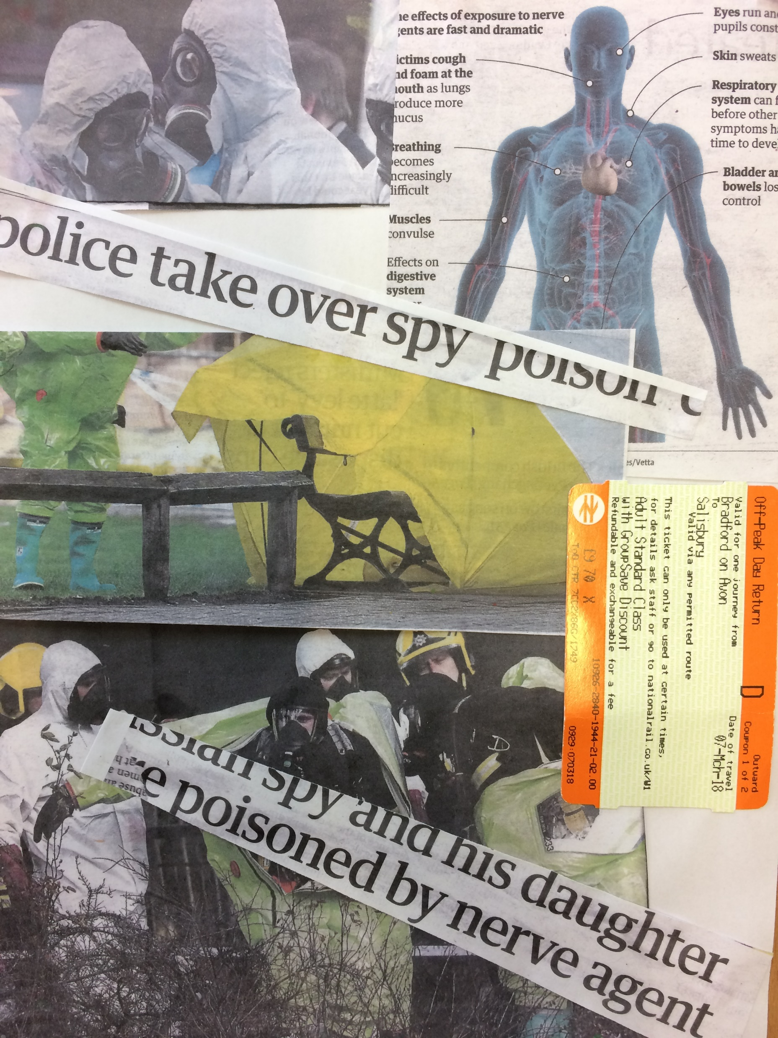
Findings
Challenge An elemental property of the LLE, overtime it transposed from extrinsic to intrinsic struggles due in part to positive boundary markers set by me in establishing a safe zone through a community of practice ( Land 2012). This ameliorated interpersonal tensions and therefore enhanced learning, risk taking, and creative/critical thinking (Taboada and Coombs 2014). All respondents felt out of their comfort zone and reported seismic shifts (Land et al 2012).
Risk-taking Led to diversity in approaches and outcomes, but evidence was scant. Maybe learners needed more time to develop the tacit knowledge, epistemic fluency (Cohen 1989: cited in Land et al 2014) and confidence necessary to become risk takers? Learning is accumulative and time-based (Land et al 2014).
The Space of the Station Had a powerful impact on participants’ perceptions, creativity, actions and emotions.
Collage in response to Novichok
poisoning 2018. (Dierdre)
Notes:
Through the continual speculative synthesis of data collection and analysis to ‘discover patterns, concepts, themes and meanings’ (Thomas 2010: 317) in the actions, identities and phrases of the protagonists I critically appraised original assumptions from the literature review that an LLE leads to changes in learning, self-awareness and risk taking. This was not entirely the case.
WHAT HAPPENED? WHEN? WHY?

Slide 11
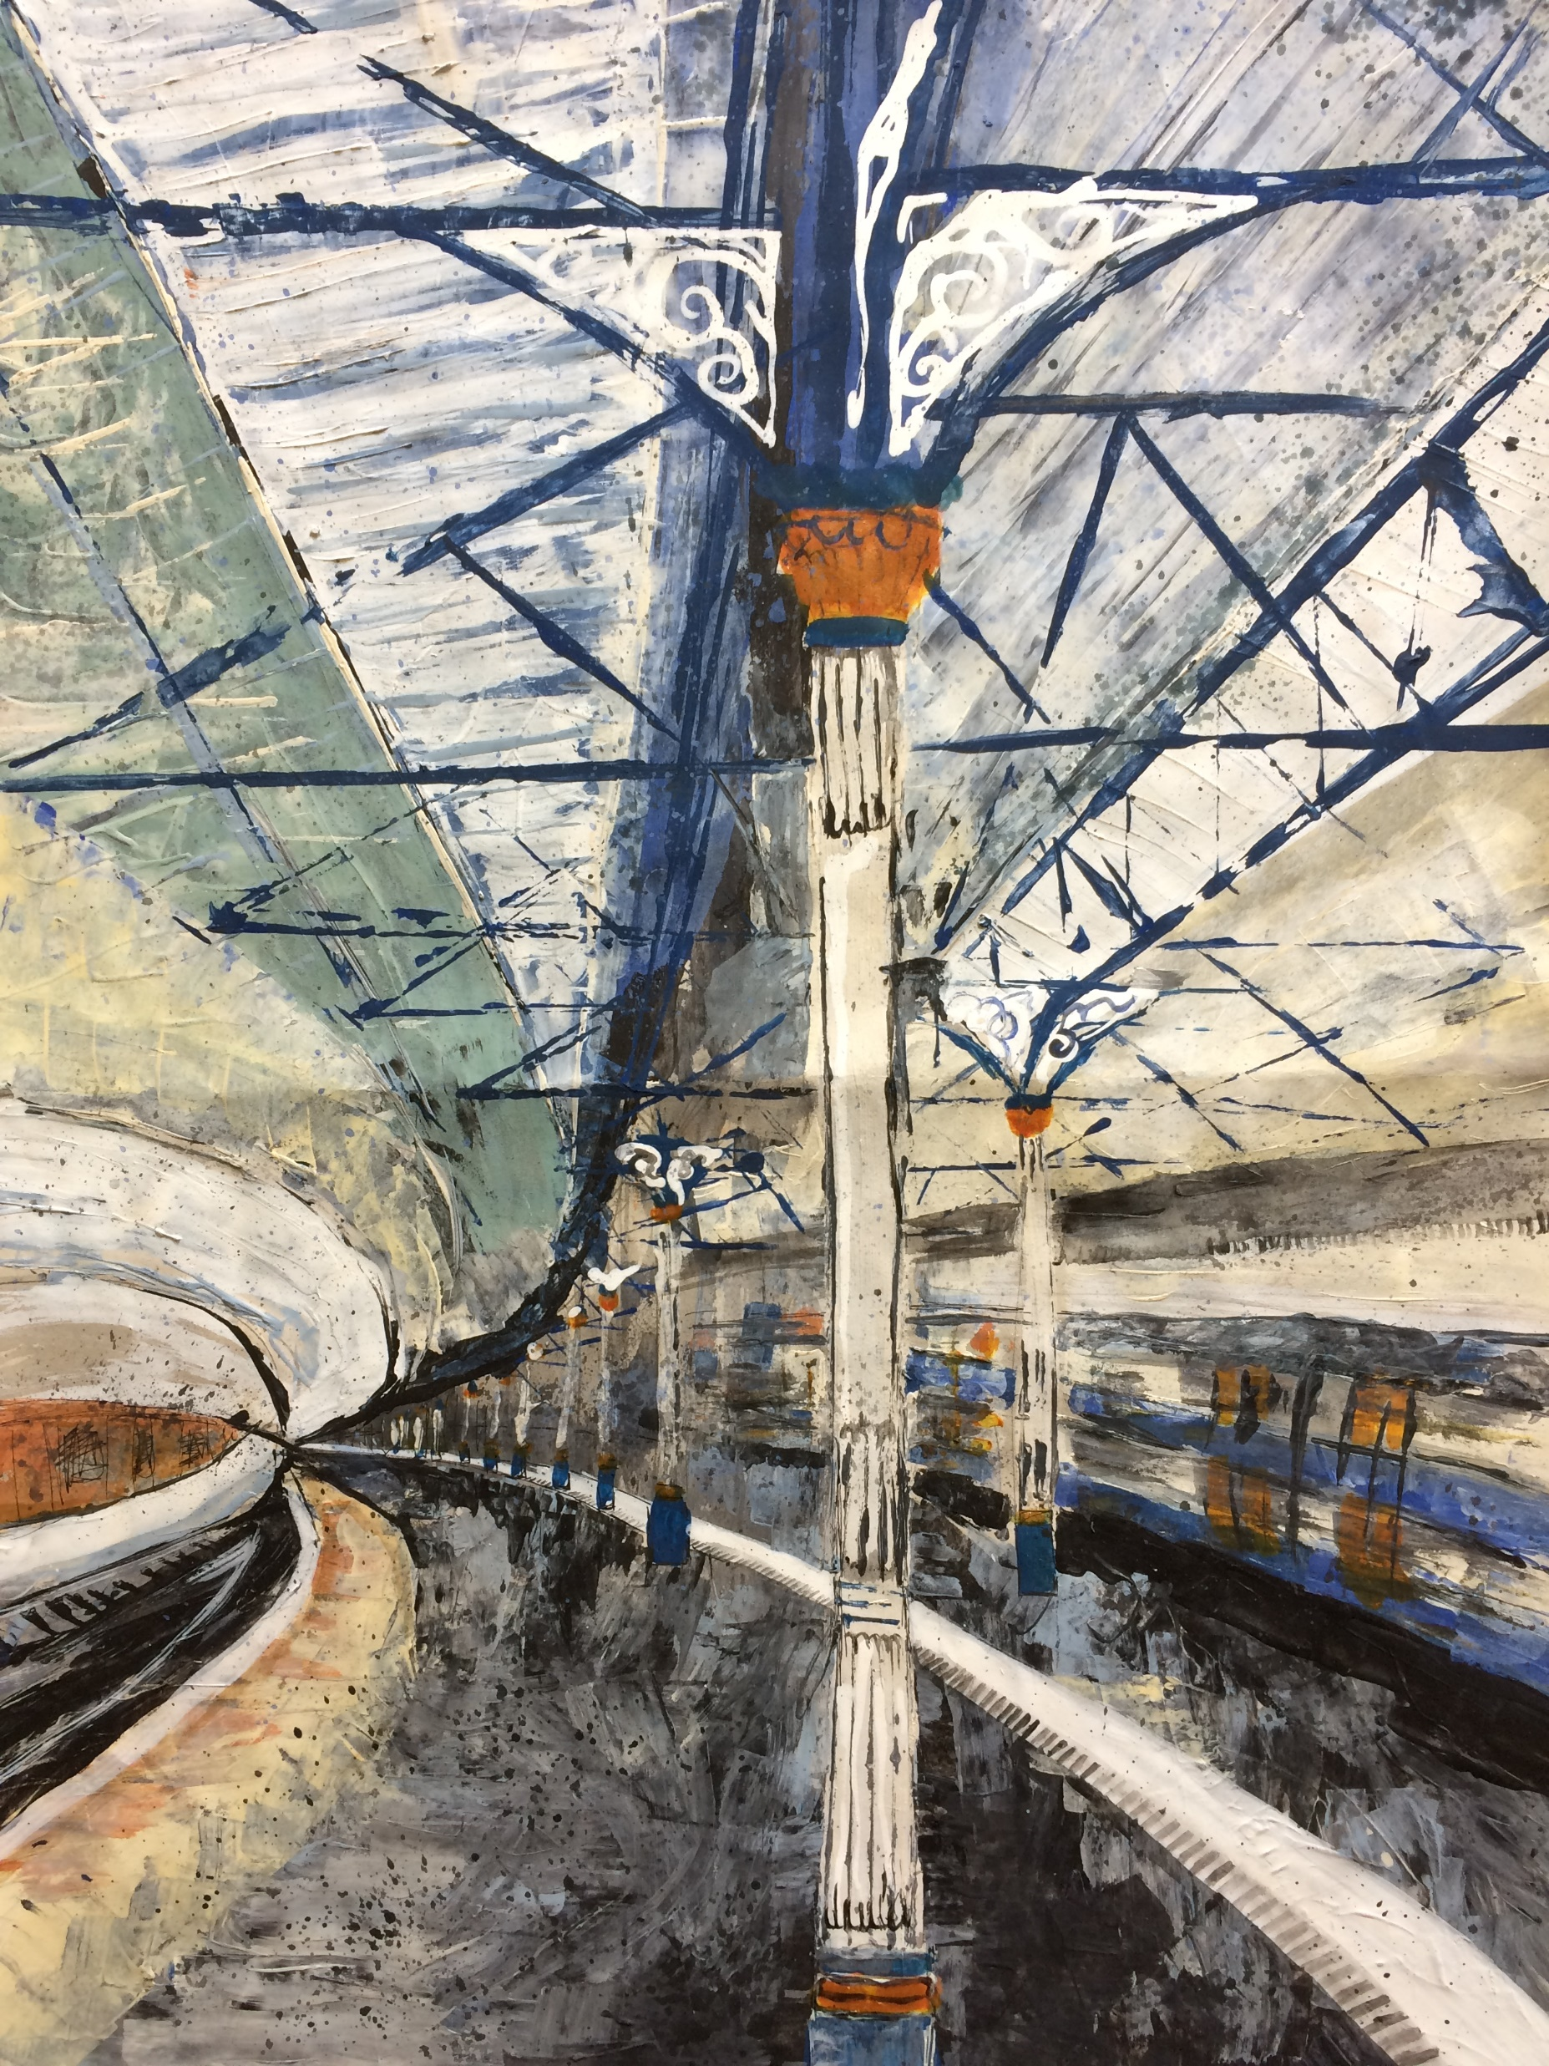
Findings
Self-awareness As a category was overarching. Each week growing and informing all aspects of practice. Resulting in changes in thinking from confusion to self-questioning, enlightenment, purpose and abstraction.
Obstacles to LLE access Age, confidence, cognitive abilities, and prior learning. Co-constructed learning is essential for universal access to a liminal state.
Next steps Online artist teacher community dissemination/delivery of LLE’s.
Acrylic painting with a credit card
2018. (Anne)
Notes:
Collaboration, shared knowledge (community of practice) and trust essential for risk-taking.

Slide 12
Conclusions
The project has profoundly affected my thoughts and behaviours as exemplified by a learner when asked the project aim:
‘Practice and acceptance that liminality changes your reasons, purposes and whole view’.
My two takeaways from this presentation are:
Self-Awareness is the most pervasive result of an LLE
Spatio-Temporal Liminal Locations are vital in evoking an LLE
Notes:
By embodying the LLE I have made endless liminal leaps through meta-cognition (self-regulation) in mimesis with the experiences of my cohort.

Slide 13
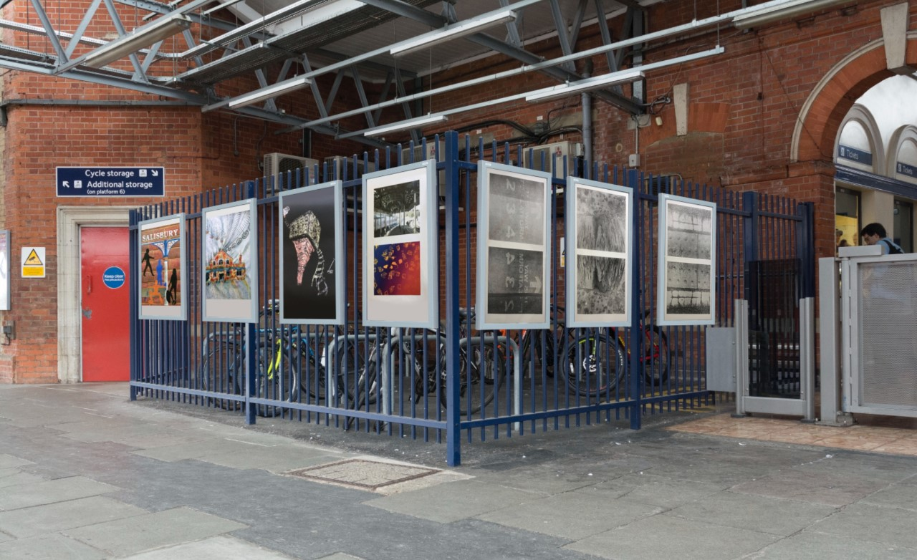
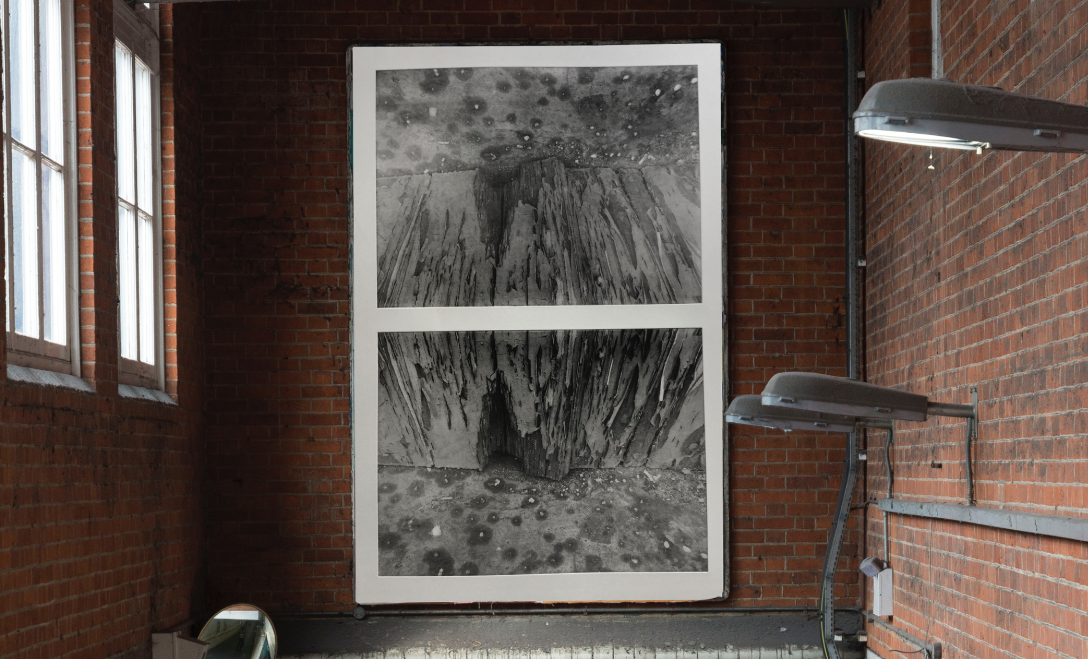
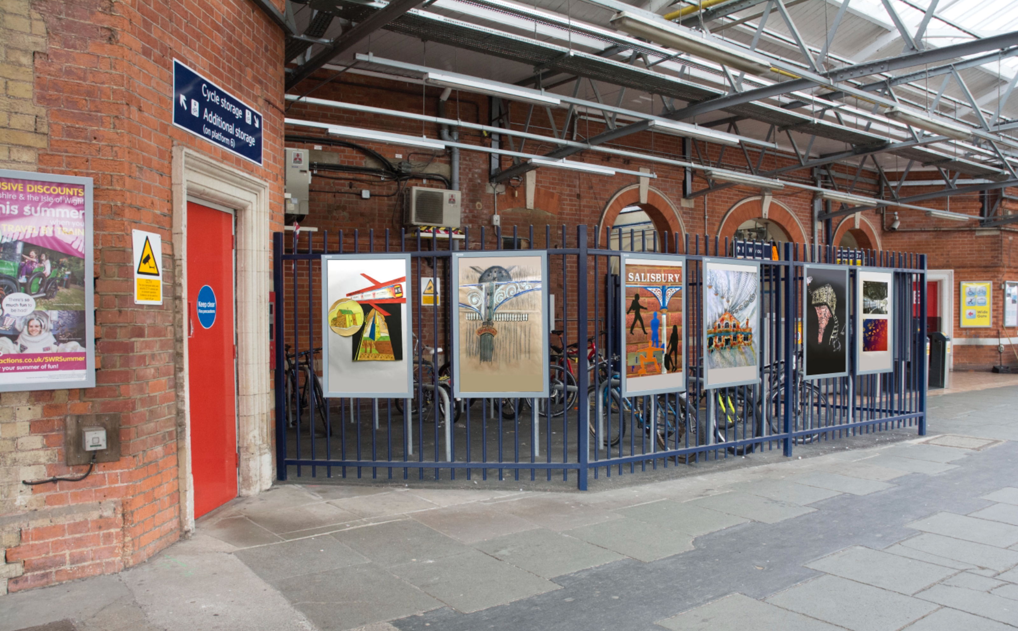
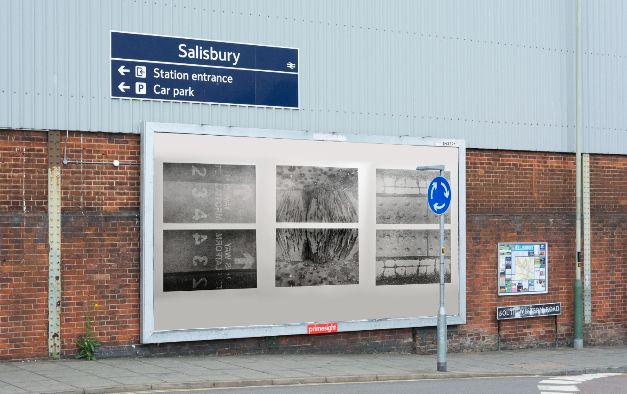
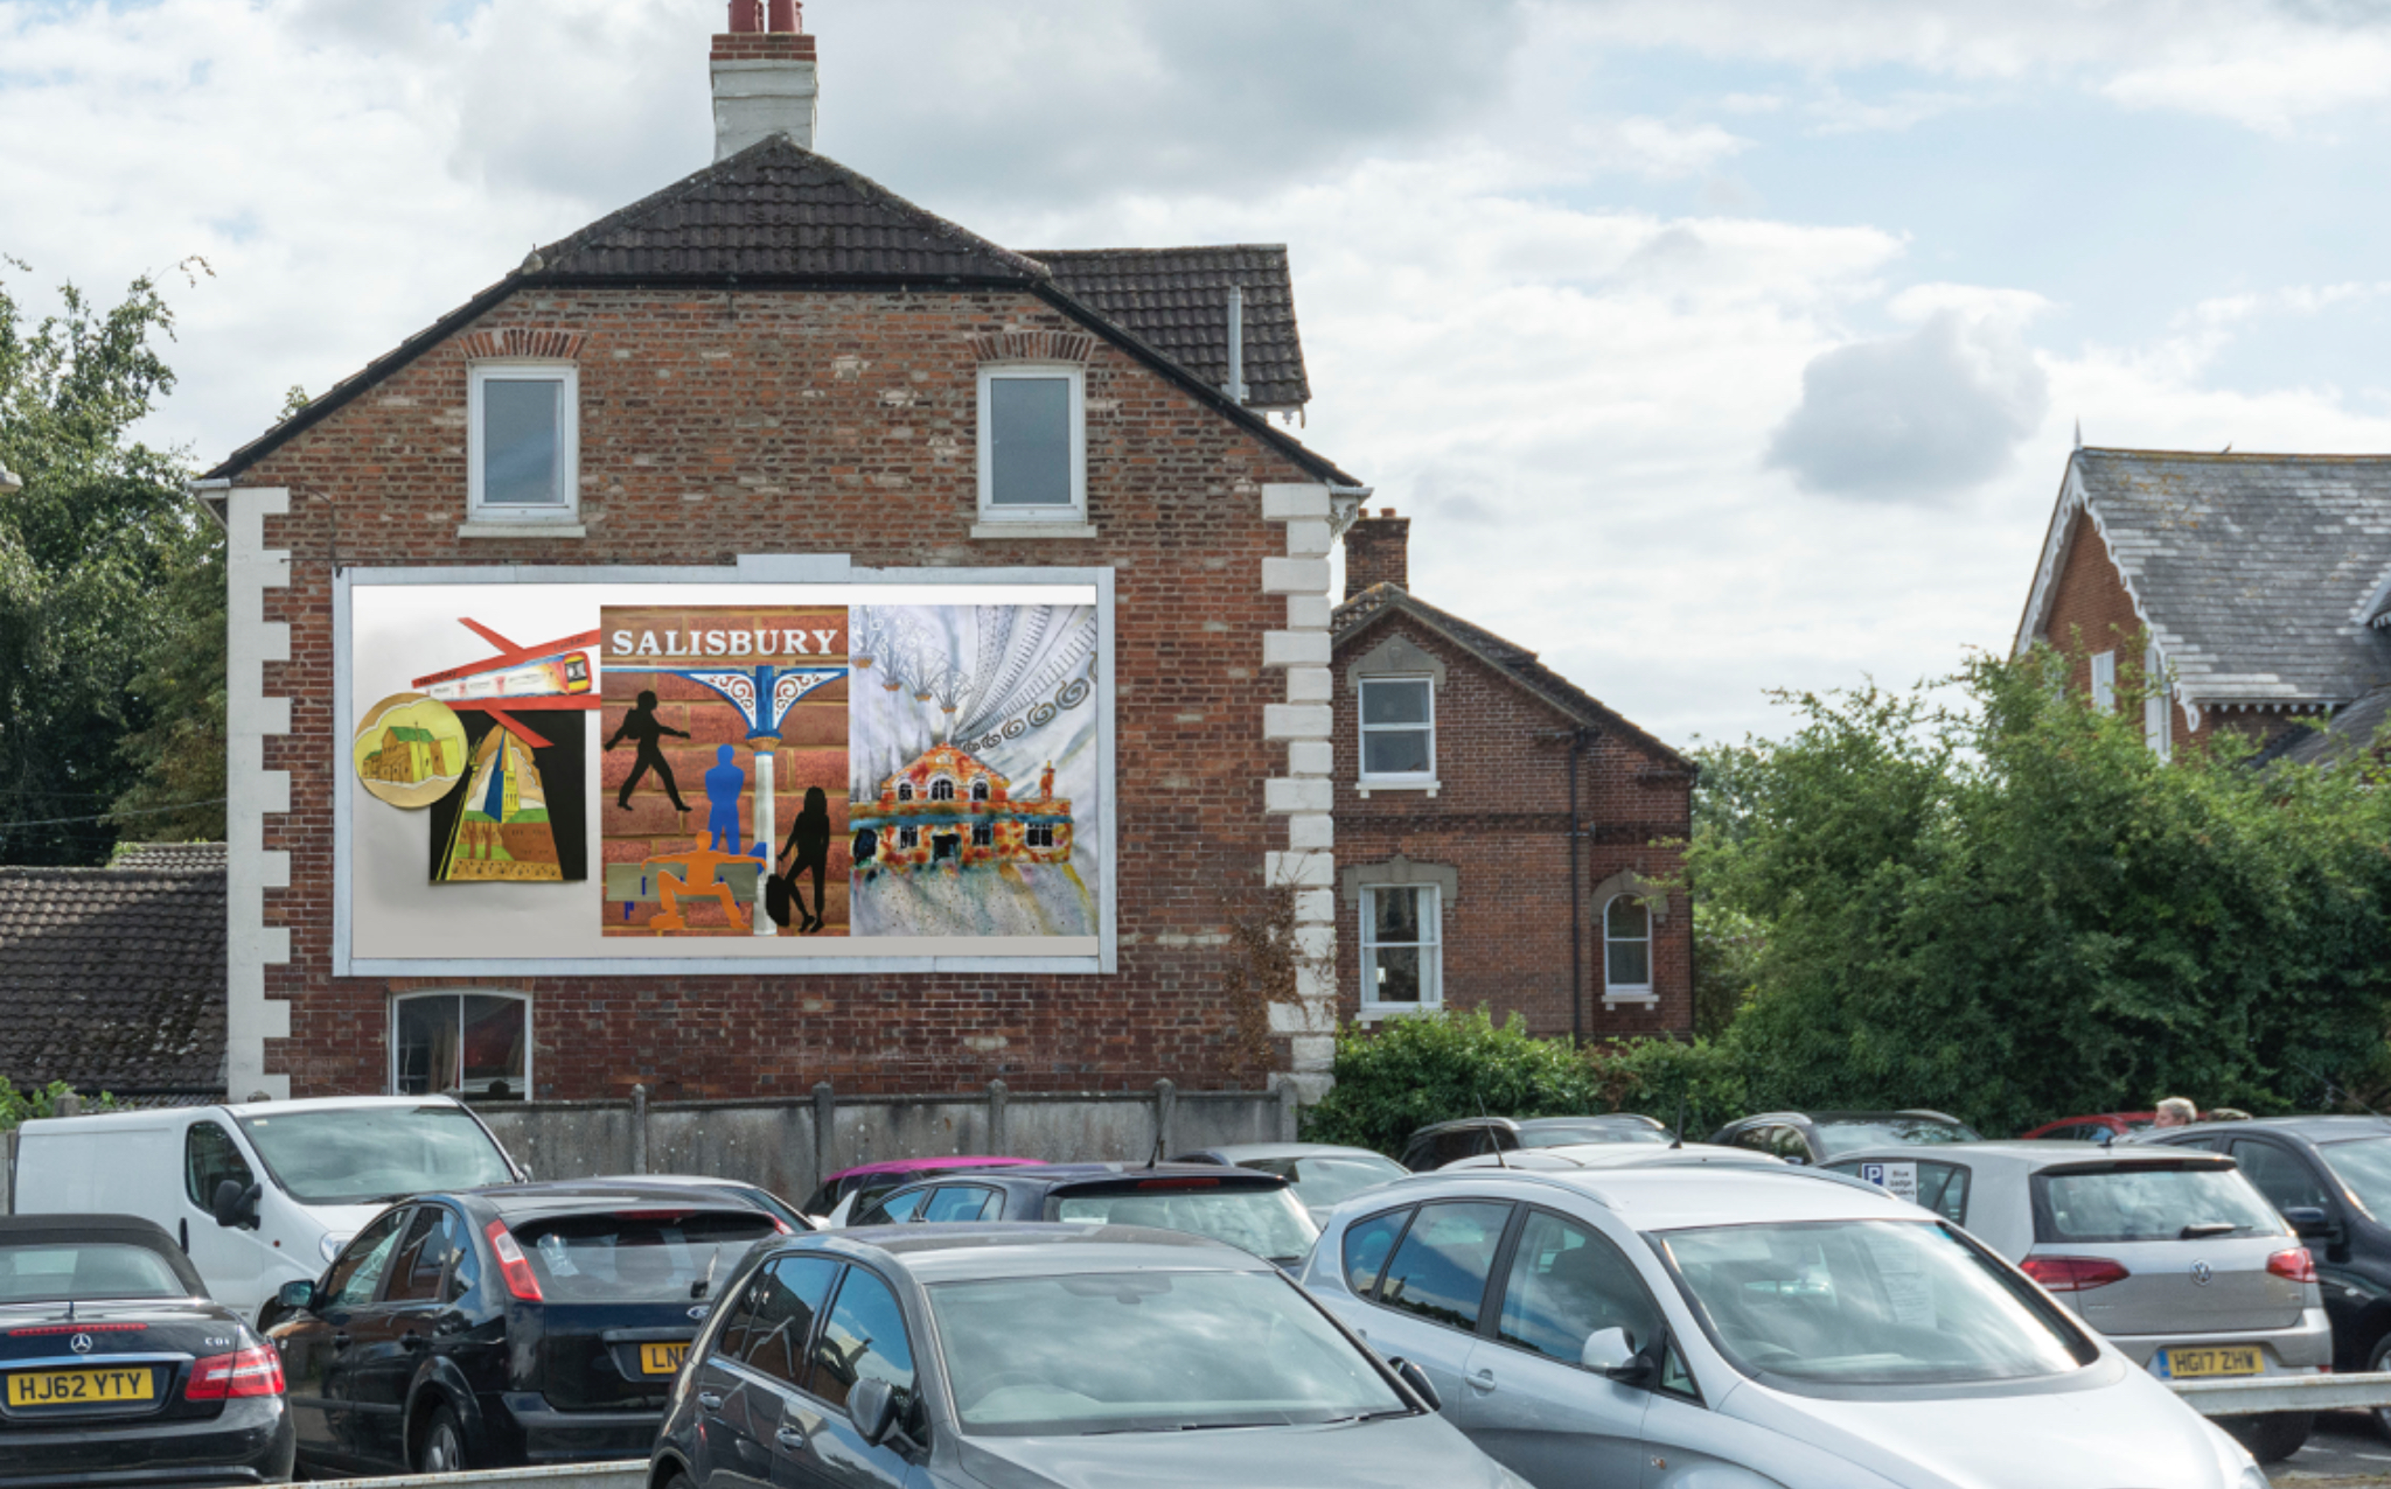
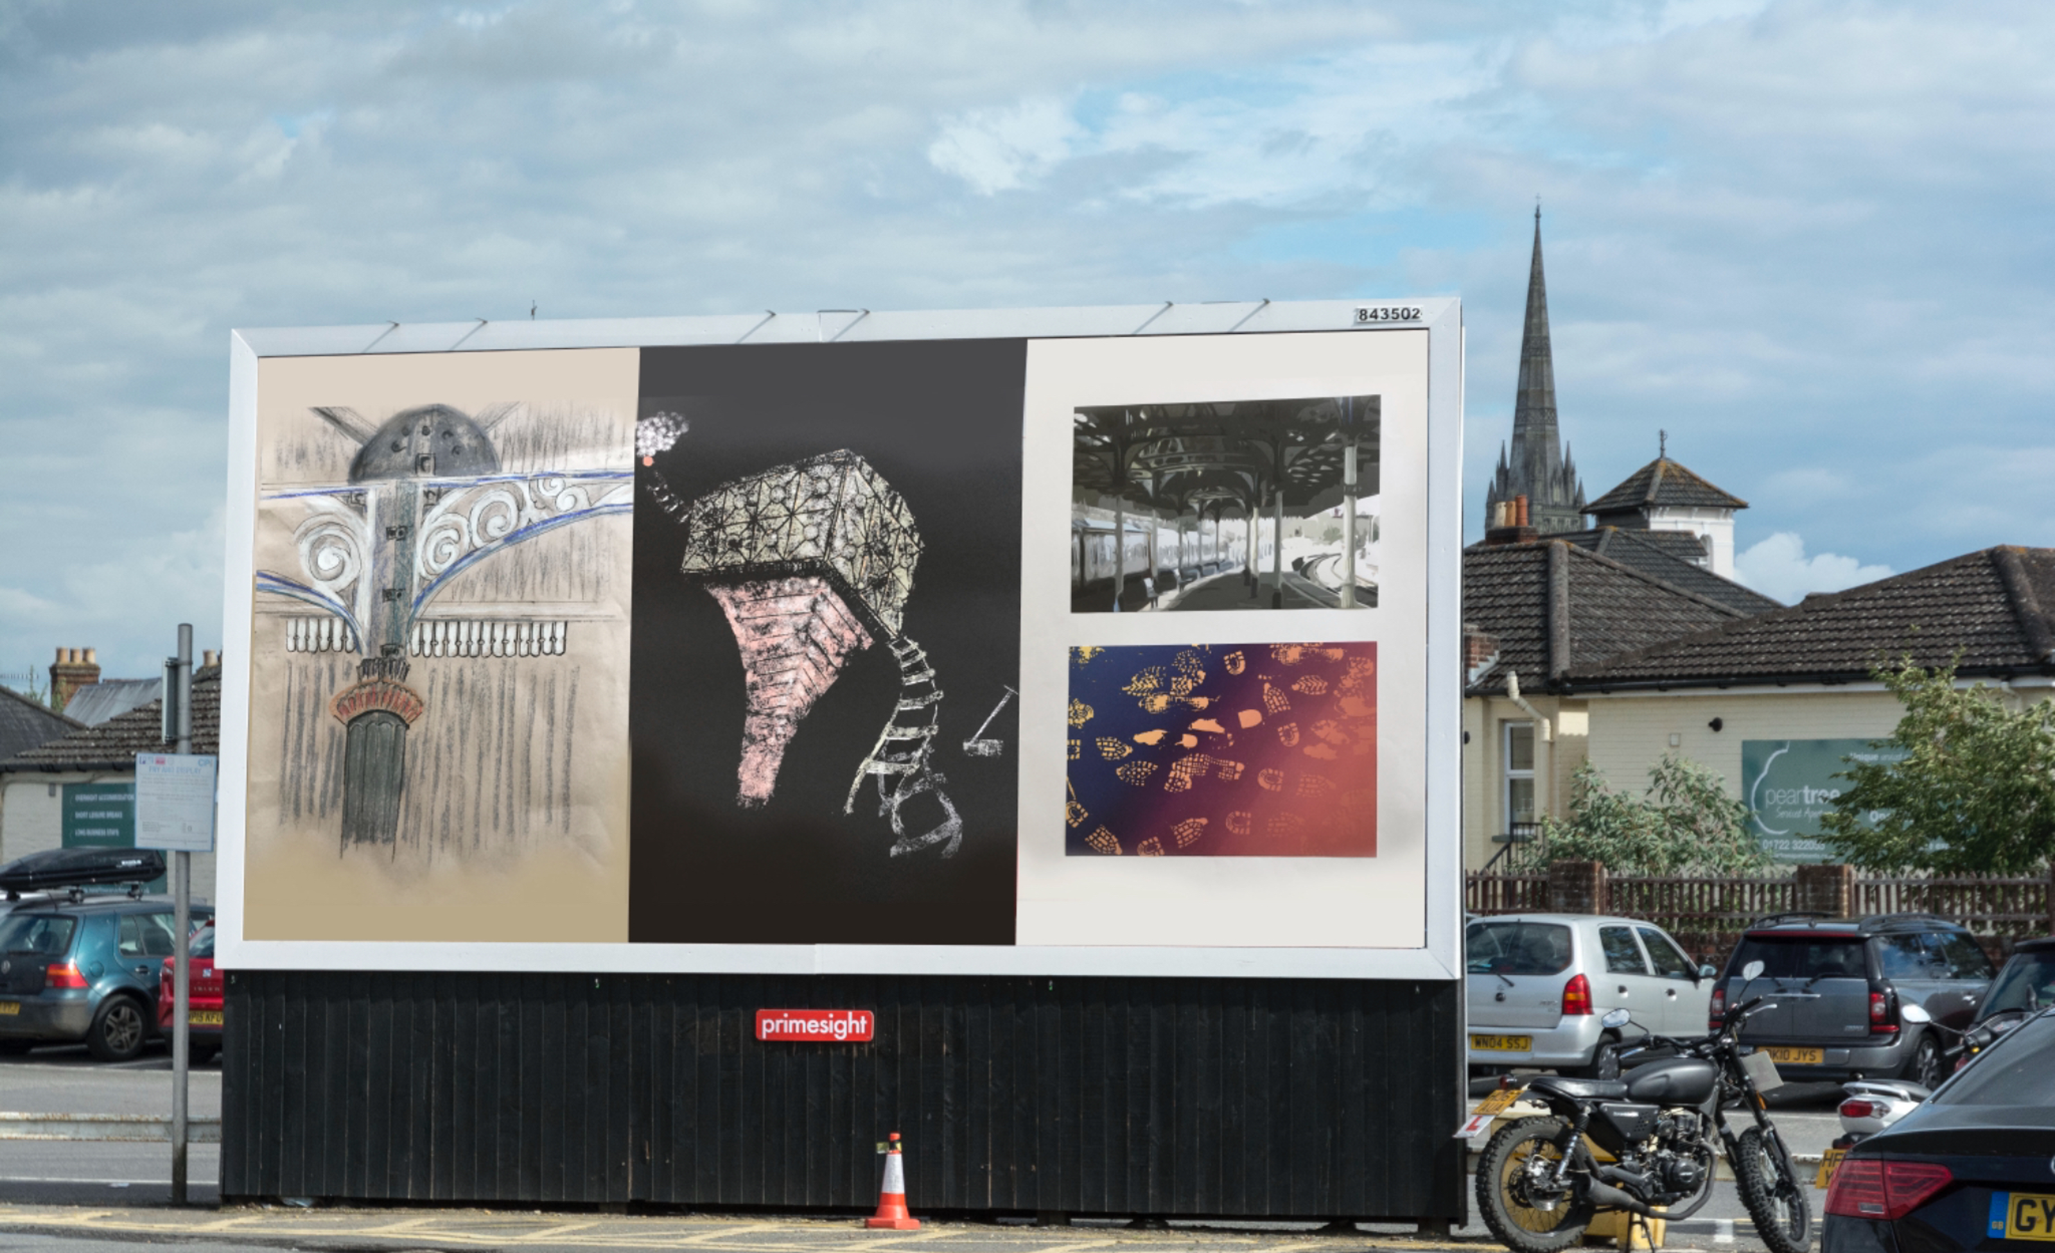
LLE Virtual Exhibition September 2018 https://echoesintime.wordpress.com www.instagram.com/liminalstates

Slide 14
References
Carr, J. (2017) Student transitions and liminal spaces The Education Blog LSE (online). Available at: http://blogs.lse.ac.uk/education/2017/09/29/student-transitions-and-liminal-spaces/ (accessed on 1.12.17)
Didau (2016) ‘Learning is Liminal’ https://learningspy.co.uk (accessed on 3.12.17)
Elliott, B. (2015) Art as a neuronarrative of liminal experience (online). Available at: https://pqdtopen.proquest.com/doc/1765416092.html?FMT=ABS (accessed on 8.1.18)
Flanagan, M. (2013) Threshold Concepts: Liminality (online). Available at: https://www.ee.ucl.ac.uk/~mflanaga/popupLiminality.html (accessed on 30.11.17)
Land, R. (2012) ‘Threshold Concepts and Educational Development’ SCAP Conference
Land, R., Rattray, J. and Vivian, P. (2014) ‘Learning in the liminal space: a semiotic approach to threshold concepts’ Higher Education, 67 (2):199-217
Rowley, C. (2018) Ambiguity and the Liminal in Contemporary Art (online). Available at: http://www.academia.edu/8297187/Ambiguity_and_the_Liminal_in_Contemporary_Art-_Chelsea_Rowley (accessed on 1.2.18)

Slide 15
References
Stewart, D. W., Shamdasani, P. N. and Rook, D. W. (2007) Focus Group Theory and Practice. London: Sage
Taboada, M. and Coombes, G. (2014) ‘Liminal Moments: Designing, Thinking and Learning’ Design and Technology Education: An International Journal 19 (1):30-39
Thomas, P. Y., (2010) Towards developing a web-based blended learning environment at the University of Botswana, University of South Africa, Pretoria (online). Available at: http://uir.unisa.ac.za/handle/10500/4245 (accessed on 5.6.18)
Thomassen, B. (2014) Liminality and the Modern: Living Through the In-Between. London: Routledge
Tucker, V.M. (2016) ‘Curriculum on the Edge: Designing for Liminality in Learning’ Sixth Biennial International Threshold Concepts Conference
Turner, V. (1967) The Forest of Symbols: Aspects of Ndembu Ritual. Ithaca: Cornell University Press
Turner, V. (1974) Liminal to Liminoid, in Play, Flow, and Ritual: An Essay in Comparative Symbology Rice Scholarship Home – Rice University (online). Available at: https://scholarship.rice.edu/bitstream/handle/1911/63159/article_RIP603_part4.pdf (accessed on 10.11.17)

