Slide 1

Mixed Methods Strategies for Handling Methodological Issues within Threshold Concept Features
QUAN
QUAL
David Reeping
University of Cincinnati (starting in August!)
dreeping@umich.edu
July 7, 2021

Slide 2
It’s perhaps no secret that threshold concepts theory has been critiqued for its weak definitions of fundamental qualities to identifying threshold concepts (e.g., Rowbottom, 2007; O’Donnell, 2009)
A threshold concept is likely to be: Transformative, […], Probably irreversible, […], Integrative, […], Possibly often (though not necessarily always) bounded, […] and Potentially (and possibly inherently) troublesome. (Meyer and Land 2003, 4–5 emphases in the original)
Weak conjunctive definition
Threshold concepts are transformative (occasioning a significant shift in the perception of a subject), integrative (exposing the previously hidden inter-relatedness of something) and are likely to be, in varying degrees, irreversible (unlikely to be forgotten, or unlearned only through considerable effort), and frequently troublesome, for a variety of reasons. (Meyer, Land, and Baille 2010, ix emphases in the original)
Mixed conjunctive definition
(Salwén, 2019)

Slide 3
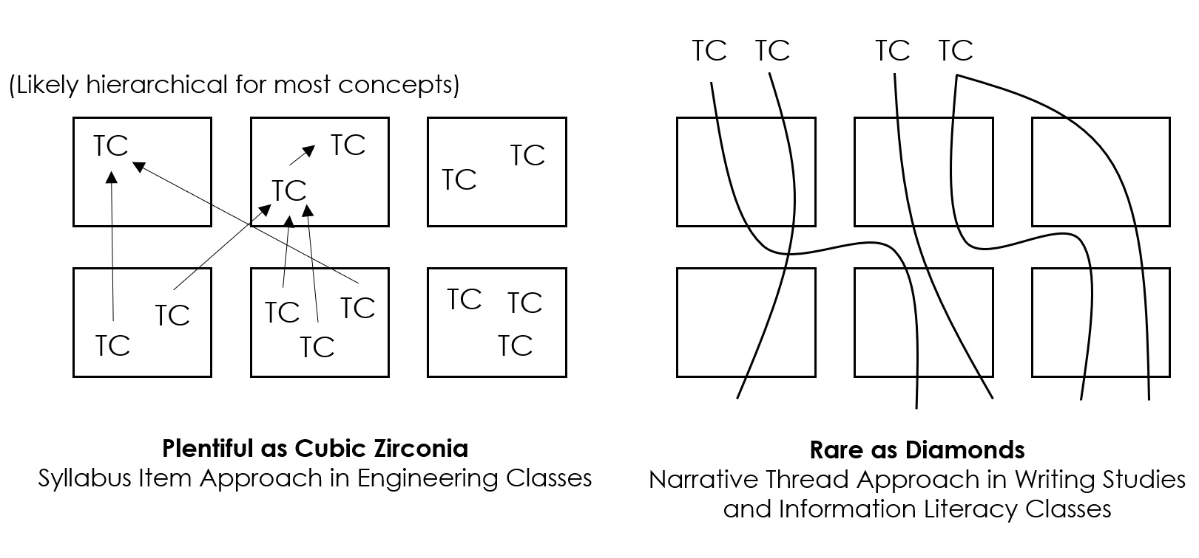
The conceptualization of threshold concepts has seemingly diverged across disciplinary lines as well, with authors using different combinations of the criteria (Salwén, 2019) and treating threshold concepts differently (i.e., concept, educational framework, theoretical framework, or research framework; Brown et al., 2021)
‘frequency domain’
‘writing is a social and
rhetorical activity.’
(Reeping, 2020)

Slide 4
Another salient issue put forward by Nicola-Richmond et al. (2018) involves the timing and length of studies concerning threshold concepts
“A number of papers have explored the acquisition of threshold concepts in an isolated
semester-long subject or unit, potentially confounding the precept that threshold concepts
are considered the ‘big ideas’ in a discipline. A number of investigations exploring threshold concepts across a whole programme curriculum identified only five to eight threshold concepts (Rodger & Turpin, 2011; Taylor et al., 2011); so it is possible that acquisition may occur over a number of years and subjects rather than over a shorter period of time. This would suggest that the measurement of threshold crossing may benefit from a whole-of-programme approach rather than being investigated in individual units.” (p. 111)
‘frequency domain’
‘writing is a social and
rhetorical activity.’
(Reeping, 2020)

Slide 5
To what end is focusing on individual qualities or batches of qualities of proposed threshold concepts advancing their use in an educational sense; what about a research sense?
Transformative
Troublesome
Discursive
Integrative
Reconstitutive
Bounded
Liminality
Building off a remark by Nicola-Richmond et al. (2018)…it’s possible that mixed methods research is needed to address definitional issues
Notes:
Liminality, troublesome, integrative, discursive are likely the ones that matter the most

Slide 6
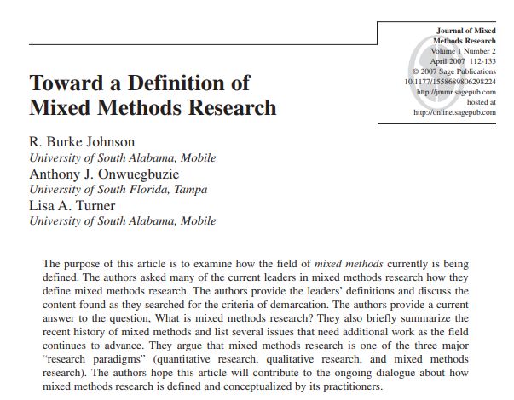
Let’s get a common definition of what we mean by mixed methods research for the sake of this presentation…
19 definitions reviewed!!

Slide 7
Let’s get a common definition of what we mean by mixed methods research for the sake of this presentation…
“Mixed methods research is the type of research in which a researcher or team of researchers combines elements of qualitative and quantitative research approaches (e.g., use of qualitative and quantitative viewpoints, data collection, analysis, inference techniques) for the broad purposes of breadth and depth of understanding and corroboration” (Johnson et al., 2007, p. 123)

Slide 8
Mixed methods designs, such as the core designs here, offer different perspectives on phenomena associated with threshold concepts, or their identification
Quantitative Data Collection and Analysis
Qualitative Data Collection and Analysis
Quantitative Data Collection and Analysis
Qualitative Data Collection and Analysis
Results connected to/ explained by
Results connected to/ build to
Results merged and compared
Quantitative measure, instrument, intervention, app, or website
Qualitative Data Collection and Analysis
Interpretation
Interpretation
Tested or applied by
Convergent
Explanatory Sequential
Quantitative Data Collection and Analysis
The convergent design in particular can highlight how we can merge data, analyses, and/or results to provide complementarity (Greene et al., 1989), providing a more holistic picture of the threshold crossing.
Interpretation
Exploratory Sequential
Creswell & Plano Clark (2018)

Slide 9
Note that using the typologies isn’t the only way to develop mixed methods designs. An interactive approach can be taken where the design is constructed by balancing the five priorities below
Conceptual Framework
Goals
Research Questions
Methods
Validity
“I don’t believe that typologies of design are useful as a starting point for designing a study, which is how they’re typically presented…The “type” of study that emerges from this process is an outcome of these decisions, rather than the starting point in making them, although this outcome then has implications for the rest of the design” (Maxwell, 2018, p. 323-324)
Maxwell (2012)

Slide 10
Designs employing a mixed methods approach (especially longitudinal) are likely the most promising toward addressing concerns raised by critics of threshold concepts, currently most studies in the sciences employ interviews and another technique like surveys (Hendrawati et al., 2021)
Qualitative Evidence
Divergence
Data collection
Threshold Concept Feature
Integration using
mixing strategies
Metainference via complementarity
Dissonance
Data collection
Quantitative Evidence
Convergence
Dissonance or divergence might happen, and it frequently does (Uprichard & Dawney, 2019). Seeking dissonance is a component of an initiation design (see Creamer, 2018) and can help us parse out features helpful in describing threshold concepts and variation within them.

Slide 11
Another consideration is the unit of analysis that mixed methods can address. Because learners are at the center of what makes threshold concepts what they are, there are two components to consider, the student as a unit and the concept as a unit
Qualitative Evidence
Concept (as situated in the disciplinary knowledge structure)
Divergence
Integration using
mixing strategies
Metainference via complementarity
Dissonance
Student experience learning the concept and demonstrating acquisition (e.g., phenomenography; Åkerlind et al., 2014; Personas, Ozkan et al., 2019)
Quantitative Evidence
Convergence
Together they provide evidence for the concept’s features as situated in the curriculum and how students experience learning the concept

Slide 12
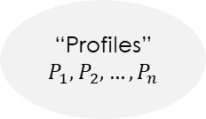
Creamer (2018) identified five broad strategies to mix, which can be nested under the main integration terms
Strategy | Description
Blending Variables and Themes Across Strands
Converting/Data Transformation
Creating a Blended Variable
Cross-Case Comparison
Extreme Case Sampling
QUAL
Theme
Data
Test with
QUAN
Test with
Data
Variable
=
QUAL
T
Data
Data
=
T
QUAN
Data
Data
QUAL
Data
Data
QUAN
Data
QUAL
Data
“Profiles”
$$P_{1},P_{2},…,P_{n}$$
QUAN
Data
QUAL
Outliers
Data
Examine with
QUAN
Examine with
Data
Outliers

Slide 13
Moran Ellis et al. (2004) developed a framework called following a thread which takes “an inductive lead to the analysis, preserving the value of the open, exploratory, qualitative inquiry but incorporating the focus and specificity of the quantitative data” (Moran Ellis et al., 2006, p. 54)
…
Dataset 1
Dataset 2
Dataset n
Analysis
Initial Analysis
Initial Analysis
Initial Analysis
Analysis
Analytic Question on TC Feature

Slide 14
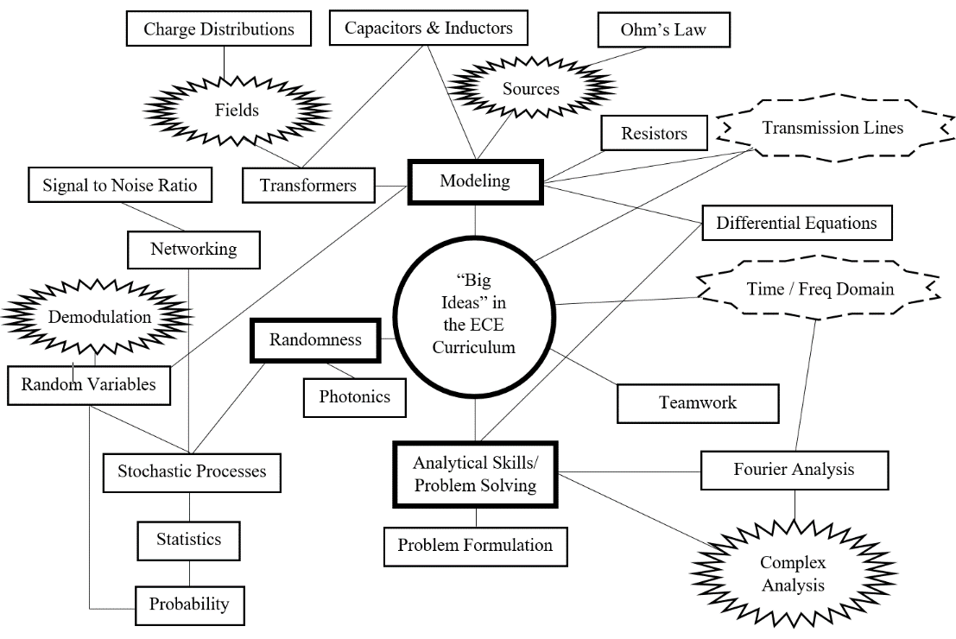
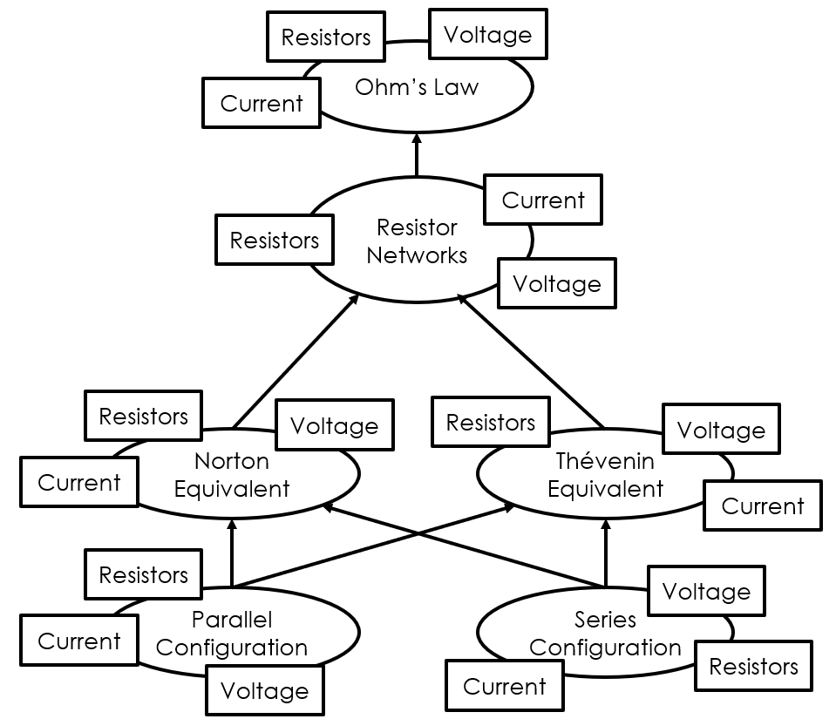
Let’s do an example. Evidence of the concept as situated in the curriculum could be elicited using quantitative techniques such as disciplinary concept graphs (DCGs; Mead & Gray, 2010) and dynamic coding procedures
Display developed via network based coding in a faculty focus group about threshold concepts (Reeping et al., 2017)
Disciplinary concept graph breaking down “complex concepts” into simpler concepts and primitives

Slide 15
This uses a data transformation to extract the connections between themes in the focus group, then leverages those results to build DCGs. The previous data can then be reanalyzed with new perspectives gleaned from the DCG analysis, which can inform…say, an interview protocol
Data Collection
Focus groups
Mixing technique
Data Transformation
Analysis
Network of concepts discussed together
Data Collection
Disciplinary Concept Graphs of discussed topics
Mixing technique
Following a thread /
Blending across strands
Analysis
Network analysis to find integrating concepts
Mixing technique
Building – create new interview protocol
Faculty / disciplinary values
How do students/faculty/practitioners discuss key concepts in the discipline?
Knowledge structure
How do students/faculty/practitioners make connections between concepts in a hierarchy?

Slide 16
Longitudinal/non-longitudinal and mono/mixed methods studies can also be reconciled using a mixed methods systematic review...a focus on methodology could elucidate what is “working” in developing techniques to identify and implement threshold concepts (e.g., Klassen et al., 2018; Johnson et al., 2019)
Qualitative conclusions Mixed conclusions Quantitative conclusions
Two-year ethnographic study with second years in economics
Compare
Questionnaire-based study with seniors in economics
Compare
Compare
Compare
Compare
Causal comparative study with middle year students in finance
Compare
Mixed methods grounded theory with first-years and seniors

Slide 17
Another common integration strategy is creating a joint display, a figure or table that juxtaposes quantitative and qualitative findings (or data), with the following form…
Overarching Constructs | Quantitative Findings | Qualitative Findings | Meta-inferences
(Fetters, 2020; Guetterman et al., 2015)

Slide 18
One technique to synthesize in a systematic mixed methods review (or any mixed methods study) is called pillar integration process (Johnson et al., 2019, p. 305)
Pillar Building
Themes
Consolidate the categories into a
single inference, do the categories
converge or diverge?
Quality check to ensure matchable
categories have been accounted for
Checking
Qualitative Categories
Quantitative Categories
Qualitative Evidence
Data on TC quality
Matching
Quantitative Evidence
Data on TC quality
Finding categories matching
across evidence types
Listing
Listing

Slide 19
The pillar integration process joint display would look like this… a slight variant on the “typical” tabular view
Quantitative data | Quantitative categories | Pillar building themes | Qualitative categories | Meta-inferences
(Johnson et al., 2019)

Slide 20
Identifying threshold concepts across the dimensions of how learners experience threshold concept acquisition and how the concept is situated in the knowledge structure requires some level of complementarity and integration using mixed methods techniques
Concept Interrelations in Knowledge Structure
Concept Placement in Curriculum, When Learned
Learners Experience Crossing Threshold
Variation within
Variation within
Confound
Faculty Experience Crossing Threshold
Variation within
Variation within
Confound
Practitioner Experience Crossing Threshold
Variation within
Variation within
Confound

Slide 21
What are the key points?
(1) The critiques of threshold concepts have not been properly resolved. The conjunctive definition of how one identifies a threshold concept is not sufficient to identify threshold concepts reliably. Identification strategies are said to be lacking even in the most recent literature.
(2) Mixed method approaches (longitudinal, if possible) capturing student experiences and disciplinary structures are likely the most rigorous way to explore the necessity of different features and where variation occurs within individual trajectories through the liminal space.
(3) Mixed method systematic reviews, along with analytical strategies like pillar integration process, following a thread, cross-case comparison, extreme case sampling, and joint displays can help explore the breadth and depth of what we hypothesize to be threshold concepts.

Slide 22
References
Maxwell, J. A. (2018). The “silo problem” in mixed methods research. International Journal of Multiple Research Approaches, 10(1), 317-327. https://doi.org/10.29034/IJMRA.V10N1A20
Mead, J., & Gray, S. (2010). Contexts for Threshold Concepts I: A conceptual structure for localizing candidates. In R. Land, J.H.F Meyer, & C. Baillie (Eds), Threshold Concepts and Transformational Learning (pp. 97-113). Rotterdam.
Moran-Ellis, J., Alexander, V. D., Cronin, A., Dickinson, M., Fielding, J., Sleney, J., & Thomas, H. (2006). Triangulation and integration: processes, claims and implications. Qualitative Research, 6(1), 45-59. https://doi.org/10.1177/1468794106058870
Moran-Ellis, J., Alexander, V.D., Cronin, A., Dickinson, M., Fielding, J., Sleney, J. and Thomas, H. (2004). Following a thread – an approach to integrating multi-method data sets [paper presentation]. ESRC Research Methods Programme, Methods Festival Conference, Oxford, United Kingdom.
Nicola-Richmond, K., Pépin, G., Larkin, H., & Taylor, C. (2018). Threshold concepts in higher education: A synthesis of the literature relating to measurement of threshold crossing. Higher Education Research & Development, 37(1), 101-114. https://doi.org/10.1080/07294360.2017.1339181
O’Donnell, R. (2009). Threshold concepts and their relevance to economics. Australasian Teaching Economics Conference, Brisbane, Australia. https://ro.uow.edu.au/cgi/viewcontent.cgi?article=3186&context=commpapers
Ozkan, D., Reeping, D., McNair, L., Martin, T., Harrison, S., Lester, L., Knapp, B, Wisnioski, M., Patrick, A, & Baum, L. (2019). Using personas as curricular design tools: Engaging the boundaries of Engineering culture. Frontiers in Education, Covington KY. https://doi.org/10.1109/FIE43999.2019.9028358
Reeping, D. (2020). Threshold concepts as ‘jewels of the curriculum’: rare as diamonds or plentiful as cubic zirconia?. International Journal for Academic Development, 25(1), 58-70. https://doi.org/10.1080/1360144X.2019.1694934
Reeping, D., McNair, L. D., Wisnioski, M., Patrick, A. Y., Martin, T. L., Lester, L., Knapp, B., & Harrison, S. (2017). Using threshold concepts to restructure an electrical and computer engineering curriculum: Troublesome knowledge in expected outcomes. Frontiers in Education Conference, Indianapolis, IN. https://doi.org/10.1109/FIE.2017.8190444
Rowbottom, D. P. (2007). Demystifying threshold concepts. Journal of Philosophy of Education, 41(2), 263-270. https://doi.org/10.1111/j.1467-9752.2007.00554.x
Salwén, H. (2019). Threshold concepts, obstacles or scientific dead ends?. Teaching in Higher Education, 26(1), 36-49. https://doi.org/10.1080/13562517.2019.1632828
Uprichard, E., & Dawney, L. (2019). Data diffraction: Challenging data integration in mixed methods research. Journal of mixed methods research, 13(1), 19-32. https://doi.org/10.1177/1558689816674650
Åkerlind, G., McKenzie, J., & Lupton, M. (2014). The potential of combining phenomenography, variation theory and threshold concepts to inform curriculum design in higher education. In J. Huisman, Theory and method in higher education research II (pp. 227-247). Emerald Group Publishing Limited.
Brown, M. E., Whybrow, P., & Finn, G. M. (2021). Do We Need to Close the Door on Threshold Concepts?. Teaching and Learning in Medicine, 1-12. https://doi.org/10.1080/10401334.2021.1897598
Creamer, E. G. (2018). Striving for methodological integrity in mixed methods research: the difference between mixed methods and mixed‐up methods. Journal of Engineering Education, 107(4), 526-530. https://doi.org/10.1002/jee.20240
Creswell, J. W., & Plano Clark, V. L. (2018). Designing and conducting mixed methods research. Sage.
Fetters, M. D. (2020). The mixed methods research workbook: Activities for designing, implementing, and publishing projects. Sage.
Greene, J. C., Caracelli, V. J., & Graham, W. F. (1989). Toward a conceptual framework for mixed-method evaluation designs. Educational Evaluation and Policy Analysis, 11(3), 255-274. https://doi.org/10.3102/01623737011003255
Guetterman, T. C., Fetters, M. D., & Creswell, J. W. (2015). Integrating quantitative and qualitative results in health science mixed methods research through joint displays. The Annals of Family Medicine, 13(6), 554-561. https://doi.org/10.1370/afm.1865
Hendrawati, R., Mulyani, S., & Wiji, W. (2021). A review for threshold concept identification methods in science. Journal of Physics: Conference Series, Jawa Barat, Indonesia. https://iopscience.iop.org/article/10.1088/1742-6596/1806/1/012192/pdf
Johnson, R. B., Onwuegbuzie, A. J., & Turner, L. A. (2007). Toward a definition of mixed methods research. Journal of Mixed Methods Research, 1(2), 112-133. https://doi.org/10.1177/1558689806298224
Johnson, R. E., Grove, A. L., & Clarke, A. (2019). Pillar integration process: A joint display technique to integrate data in mixed methods research. Journal of Mixed Methods Research, 13(3), 301-320. https://doi.org/10.1177/1558689817743108
Klassen, K. M., Douglass, C. H., Brennan, L., Truby, H., & Lim, M. S. (2018). Social media use for nutrition outcomes in young adults: a mixed-methods systematic review. International Journal of Behavioral Nutrition and Physical Activity, 15(1), 1-18. https://doi.org/10.1186/s12966-018-0696-y
Maxwell, J. A. (2012). A realist approach for qualitative research. Sage.

